Slide 1
PORTFOLIO
Mariyana Mileva

Slide 2
CONTENTS
Front-end Development
User-Centered Design
Media Production
Professional skills

Slide 3
Front-end development
Interactive map of Europe, Weather API & NodeJS

Slide 4
INTERACTIVE MAP OF EUROPE
Learning outcomes:
LO1 – Interactive media products
LO2 – Transferable code

Slide 5
WEATHER API
Learning outcomes:
LO1 – Interactive media products
LO2 – Transferable code

Slide 6
Email form - NodeJS
Learning outcomes:
LO1 – Interactive media products
LO2 – Transferable code

Slide 7
User-centered design
Online store prototype

Slide 8
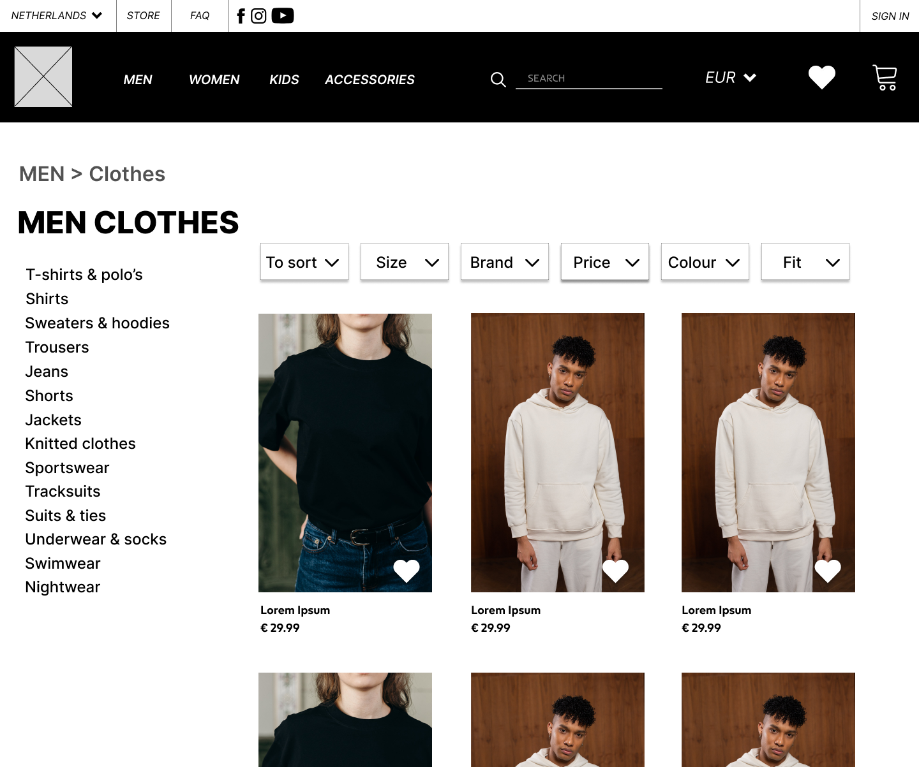
Online store prototype
Learning outcomes:
LO1 – Interactive media products

Slide 9
MEDIA PRODUCTION
Poster

Slide 10

POSTER
Learning outcomes:
LO1 – Interactive media products
LO3 – Creative iterations

Slide 11
Professional skills
Guest lecturer, Career day, Vue

Slide 12
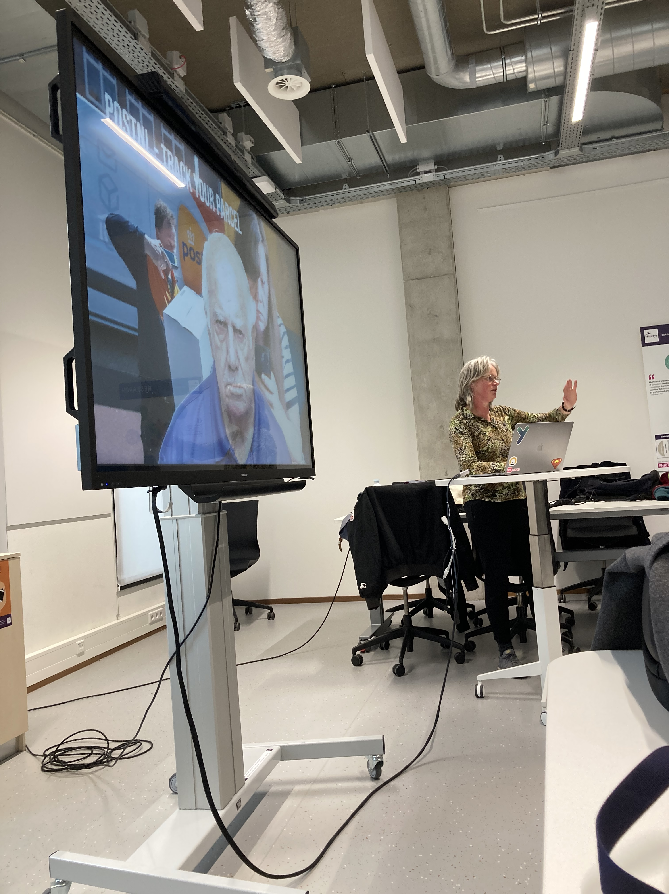
Guest lecturer
Learning outcomes:
LO4 – Professional skills

Slide 13
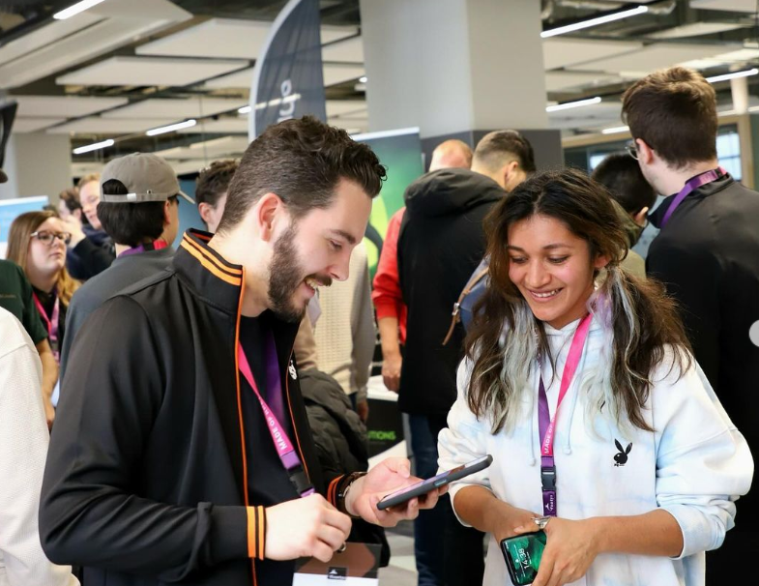
Career day
Learning outcomes:
LO4 – Professionals skills

Slide 14
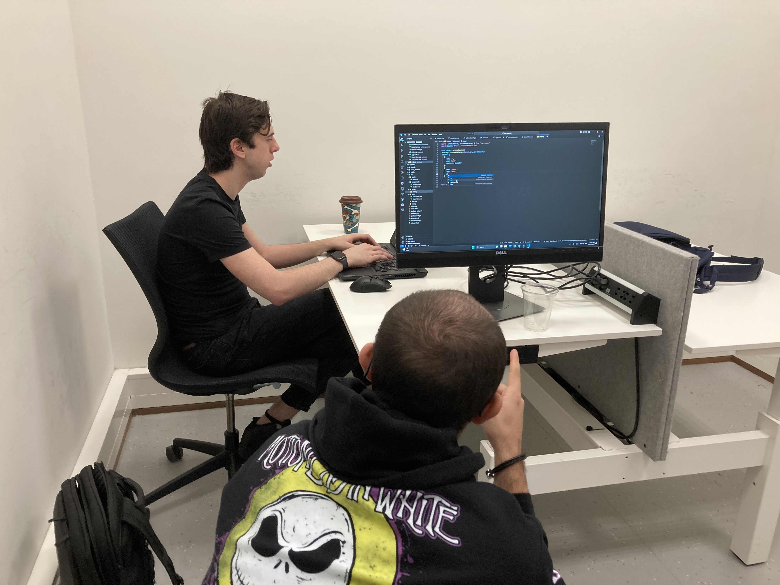
VUE
Learning outcomes:
LO4 – Professional skills

